Slide 1
Comprehensive Audit and Analysis for Effective Digital Presence

Slide 2
Agenda
Introduction
Building confidence
Engaging the audience
Visual aids
Final tips & takeaways

Slide 3


Slide 4
Wipro is a leading Indian multinational corporation specializing in information technology (IT) services, consulting, and business process services.
Headquartered in Bengaluru, India, it operates in over 60 countries, serving clients across various industries.

Slide 5
Website Audit Report:

Slide 6

Title Tag
Here the length of the title tage is 63 characters.
but for good SEO, it should ideally be between 50 and 60 characters.

Slide 7

Meta Description Tag
<meta name="description" content="Digital transformation services enhance business agility. Leverage Wipro&#39;s IT consulting, FullStride Cloud, Engineering Edge, and AI capabilities for growth"/>
The length of the meta desc is 156 character.
but for good SEO, it should ideally be between 120 and 160 characters.
However, it's best to place the main keyword within the first 120 characters to ensure it is visible on mobile devices.

Slide 8
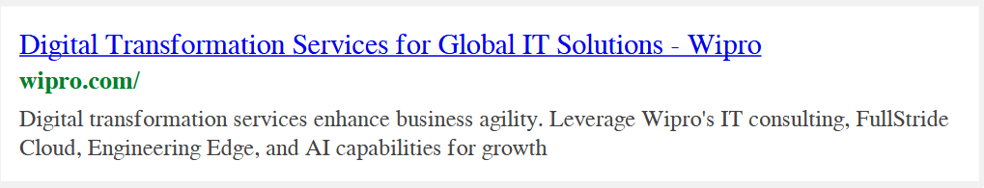
Snippet Preview

Slide 9
Language Tag
The page is using the lang attribute.
Language tag is used to set the language.

Slide 10
Headings

Slide 11
Headings

Slide 12
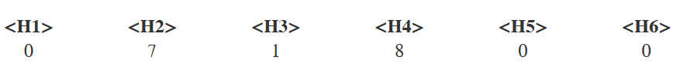
Headings
H5 and H6 tags are not used. While they are not mandatory.
But H1 tag is mandatory atleast must have 1.

Slide 13
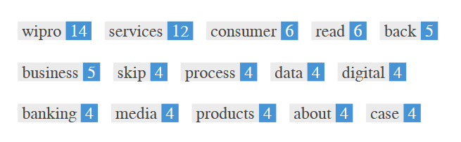
Keywords

Slide 14
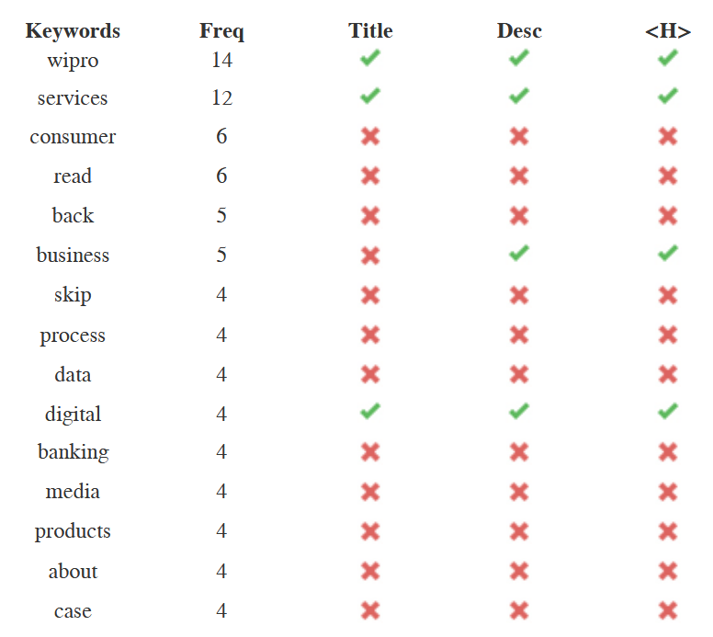
Keyword Consistency

Slide 15
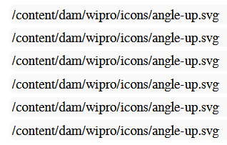
Alt Attributes
The alt attribute is used inside the image tag to describe the image content.
6 ALT attributes are empty or missing.

Slide 16
Text to HTML Ratio
Text to HTML ratio is a metric that compares the amount of visible text content on a webpage to the amount of HTML code (including tags, scripts, and markup).
Formula:
Text to HTML Ratio=(Number of Text Characters / Total Number of HTML Characters )×100%

Slide 17

Text to HTML Ratio
Here , Text content size = 7028 bytes
Total HTML size = 155571 bytes
1 byte = 1 character
=(7028/155571​)×100=4.52%
Here ,HTML to Text Ratio is: 4.52%
A ratio of 4.52% is very low.
It means this page has a lot more code compared to the visible text content.
For good SEO and user experience, they typically want this ratio to be between 20% and 70%

Slide 18
GZIP compression
GZIP is a file compression method that reduces the size of HTML or any other text files before sending them from the server to the browser.
This helps websites load faster, which is great for both user experience and SEO

Slide 19
GZIP compression
Keeping files under 100 KB helps with:
Faster page load times
Better user experience
Improved SEO rankings

Slide 20
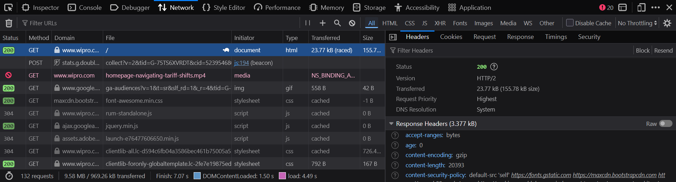
GZIP compression

Slide 21
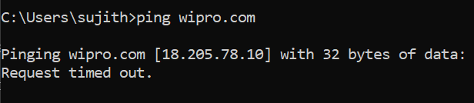
IP Canonicalization
IP Canonicalization means setting up our server so that requests to the IP address redirect to our domain name.
To identify the ip address we can use command prompt and need to use ping wipro.com

Slide 22
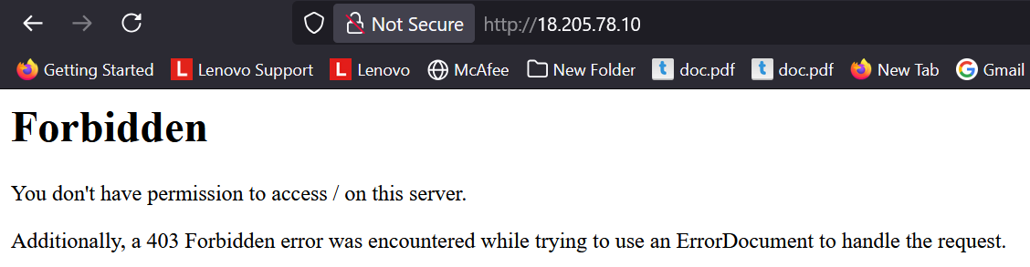
IP Canonicalization

Slide 23
URL Rewrite
URL rewriting is the process of converting long or dynamic URLs into clean, readable, and SEO-friendly URLs.
This website url looks clean and good looking.
https://www.wipro.com/applications/
https://www.wipro.com/contact-wipro/
https://www.wipro.com/what-we-think/
https://www.wipro.com/analytics/
https://www.wipro.com/newsroom/

Slide 24
Underscores in the URLs
They are not using undescores in the url its good.
https://www.wipro.com/contact-wipro/
https://www.wipro.com/what-we-think/
https://www.wipro.com/new-age-media/
https://www.wipro.com/engineering-construction-operations/
https://www.wipro.com/travel-and-transportation/

Slide 25
WWW Resolve
WWW resolve means redirecting either the www or non-www version of a website to the preferred version, so users and search engines always land on a single consistent URL.
In this website they optimized for that.

Slide 26
XML SiteMap
XML Sitemap is a file that lists all important pages of a website in a structured format to help search engine to discover and index them more efficiently.
https://www.wipro.com/sitemap.xml

Slide 27
Robots.txt
robots.txt is a simple text file placed in the root directory of a website that tells search engine crawlers which pages or sections of the site they are allowed or not allowed to crawl and index.
https://www.wipro.com/robots.txt

Slide 28
Embedded Objects
Embedded Objects are media or content elements like images, videos, audio, flash files, or other external resources that are inserted or embedded within a webpage.
Examples: <img>, <video>, <audio>, <iframe>, <embed>, <object> tags.
If any one of the embedded object tag is present on the page, then our test for “presence of embedded objects” passes.
In this website we have only <img> tag as a
embedded object.

Slide 29
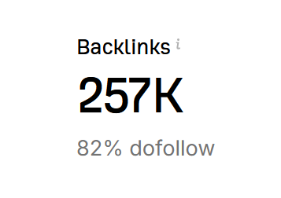
Backlink Counter
A Backlink Counter is a tool or feature that shows the number of backlinks pointing to a website or webpage.
https://ahrefs.com/backlink-checker
Wipro has

Slide 30
URL
For the best SEO, we need to keep our URL between 50 to 115 characters, and always make them human-readable and keyword-focused.
https://www.wipro.com/
Length: 5 characters
https://www.wipro.com/banking/
Length: 12 characters

Slide 31
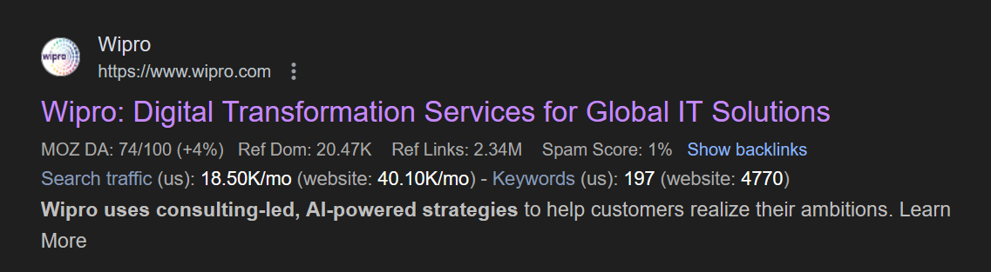
Favicon
Favicon imporves a brand visibility.

Slide 32
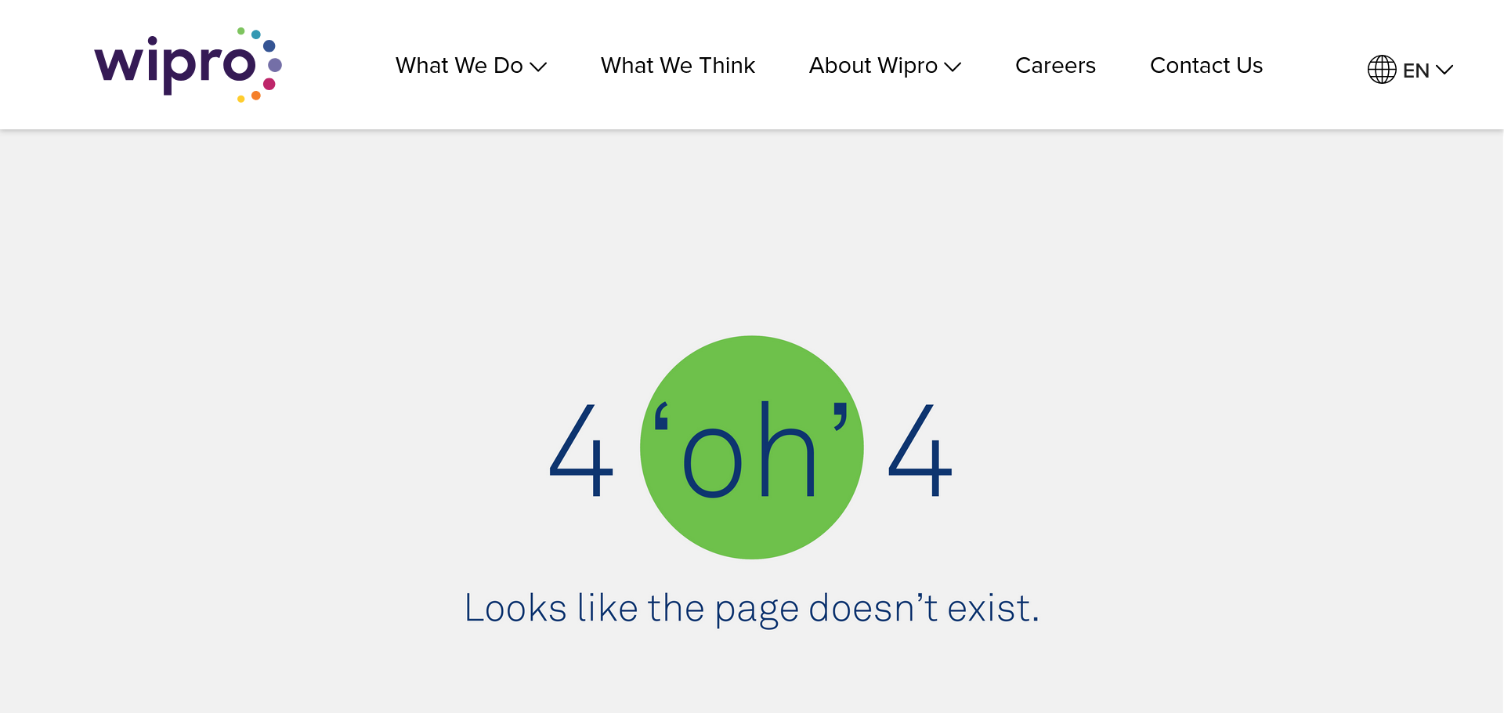
Custom 404 Page
A Custom 404 Page is a personalized web page that visitors see when they try to access a URL on our website that doesn’t exist or is broken.

Slide 33
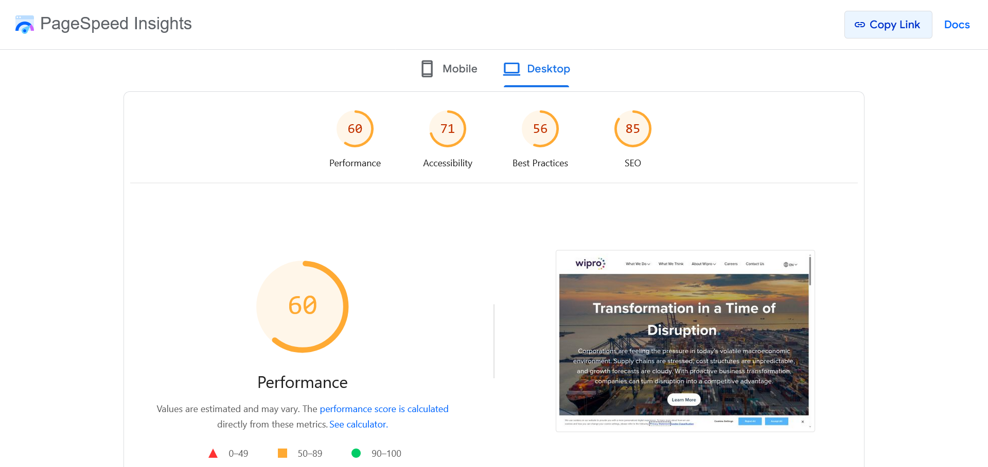
Desktop Score

Slide 34
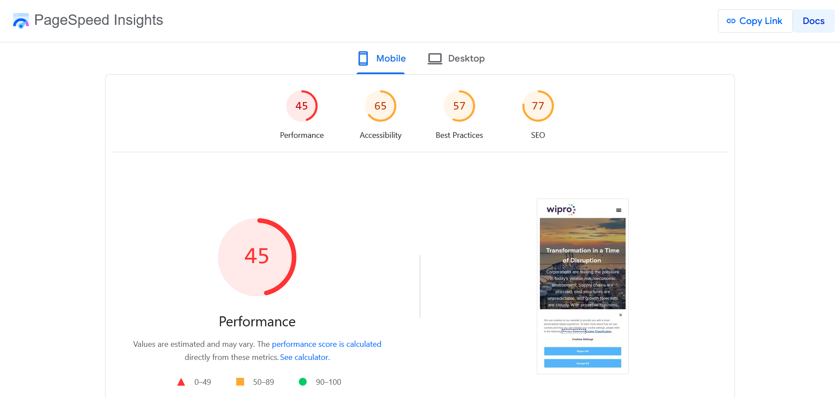
Mobile Score

Slide 35
Overall Design and Navigation Review
The website has a clean and visually appealing design.
The layout is well-structured, and the color scheme is consistent and professional.
All main navigation buttons and links are functioning properly, providing a smooth user experience.
The menu is easy to access, making it simple for users to explore different sections of the site.

Slide 36
Issue Noted – Overlapping Text in Banner:
There is a design issue on the homepage banner where the scroll indicator overlaps with text in the background.
On the homepage, some text appears partially hidden behind the menu bar when the page first loads.

Slide 37
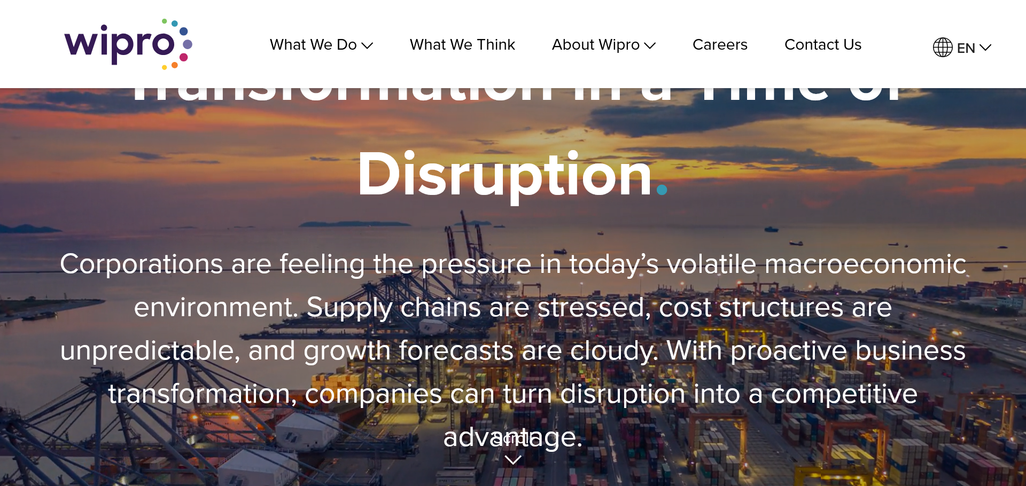
Overlapping Text in Banner

Slide 38
Recommendation
Adjust the scroll icon position to separate it from the banner text.
Adjust the layout spacing on the top of the banner it will solve the overlap of the text.

Slide 39
Recommendations to Align Traditional and Digital Marketing Goals for Wipro

Slide 40
1. Reuse Offline Webinars Across Digital Platforms
Wipro can record offline webinars or seminars and reuse the content by:
Uploading on YouTube for long-term visibility
Streaming live on Instagram or Facebook to reach a wider audience
Adding QR codes during the event to direct attendees to Wipro’s official website

Slide 41
2. Add QR Codes and Web Links in Traditional Ads
In traditional advertisements (like newspapers, magazines, brochures), Wipro should include:
QR codes or short website links
That lead users directly to a landing page or service detail page

Slide 42
3. Use the Same Message in Online & Offline Ads for Brand Recall
Wipro should maintain consistent messaging across all platforms — whether it's a:
Newspaper ad
LinkedIn sponsored post
Google banner ad
This helps people not just customers, but everyone to recognize and remember Wipro easily.
It improves brand recall and builds a strong global brand image.

Slide 43
4. Follow Up Offline Engagements With Digital Campaigns
After meeting people through events or face-to-face interactions, Wipro can:
Send follow-up emails, WhatsApp messages, or LinkedIn connections
Share related services, offers, or content links

Slide 44
5. Track Offline-to-Online Performance Using Analytics
To understand if traditional marketing is working, Wipro should:
Use Google Analytics, UTM tracking links, and campaign tags
Monitor how many users visit the website through QR codes or printed links

Slide 45
create a website landing page

Slide 46
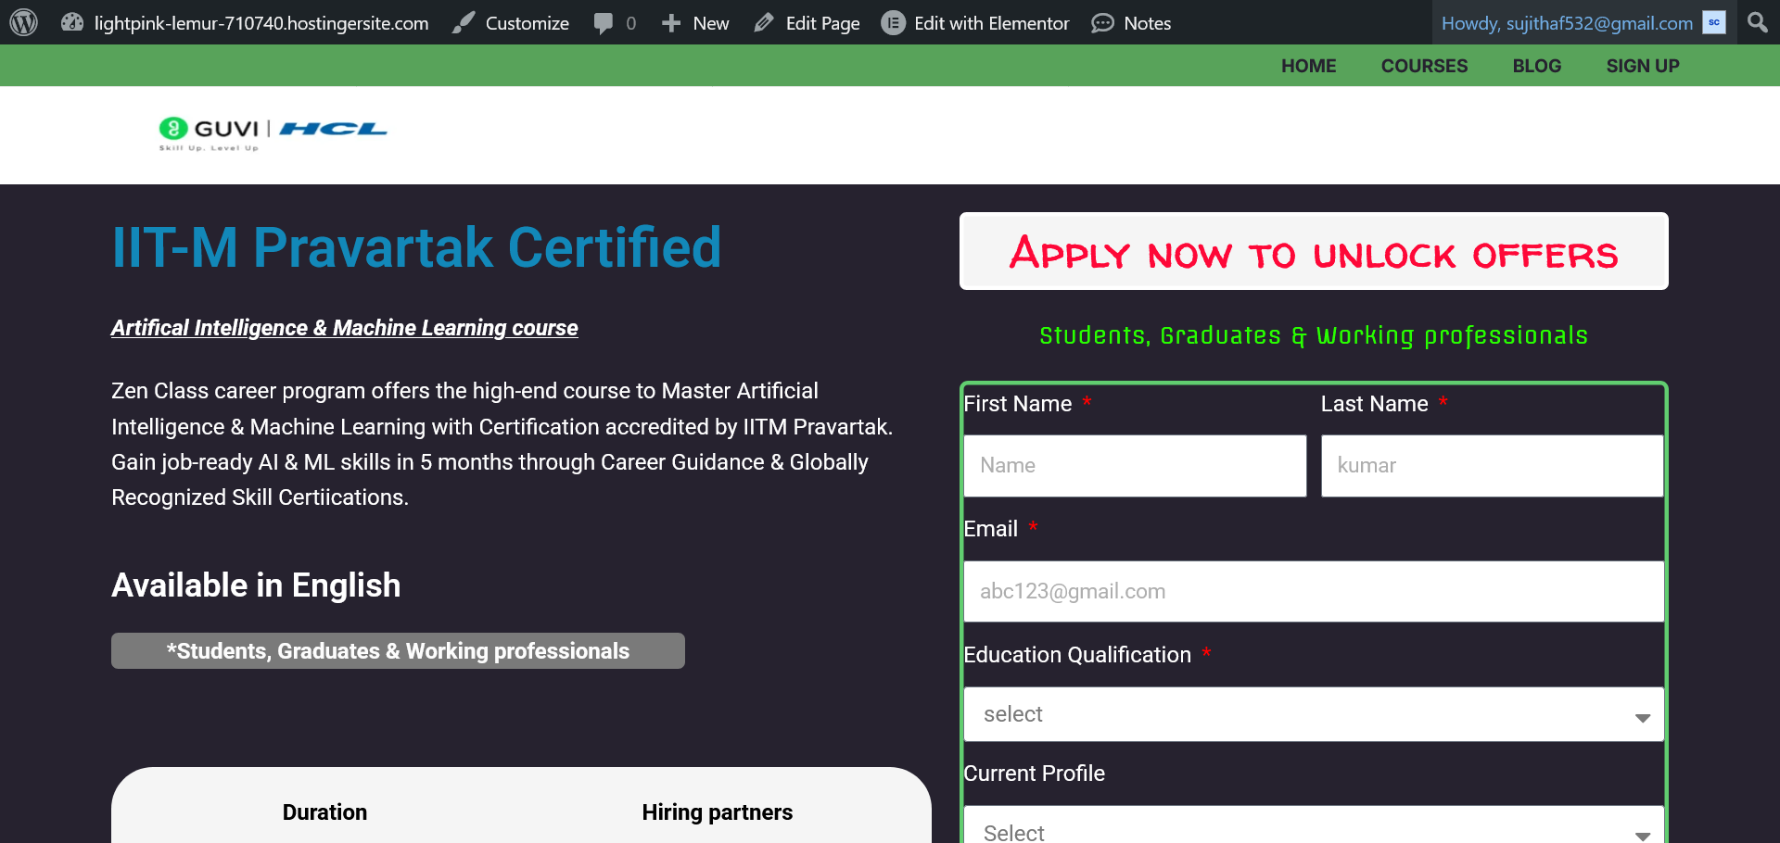

Slide 47
Landing Page
Sample landing page
https://www.guvi.in/mlp/artificial-intelligence-and-machine-learning-course
Recreated page
https://lightpink-lemur-710740.hostingersite.com/artifical-intelegince/

Slide 48
Thank you

